Slide 1
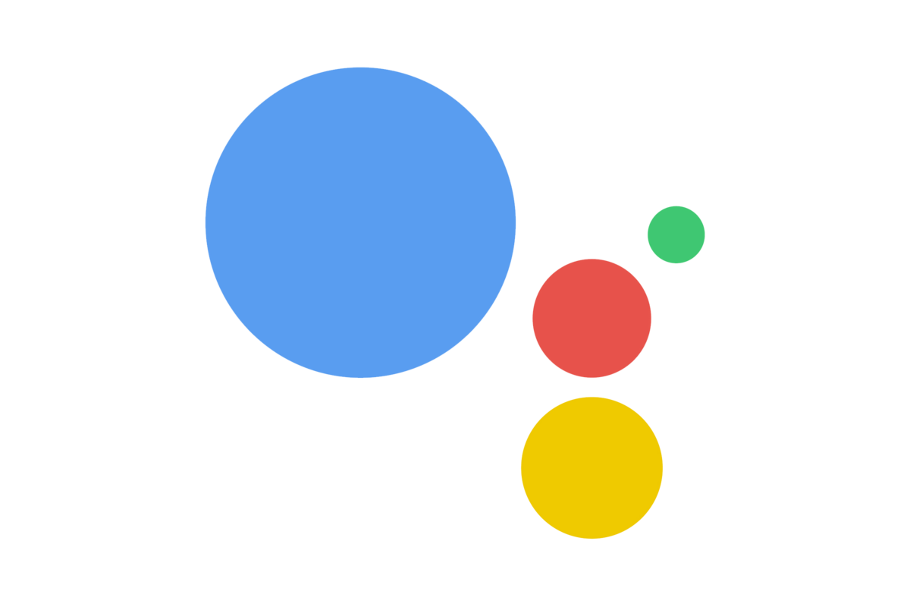
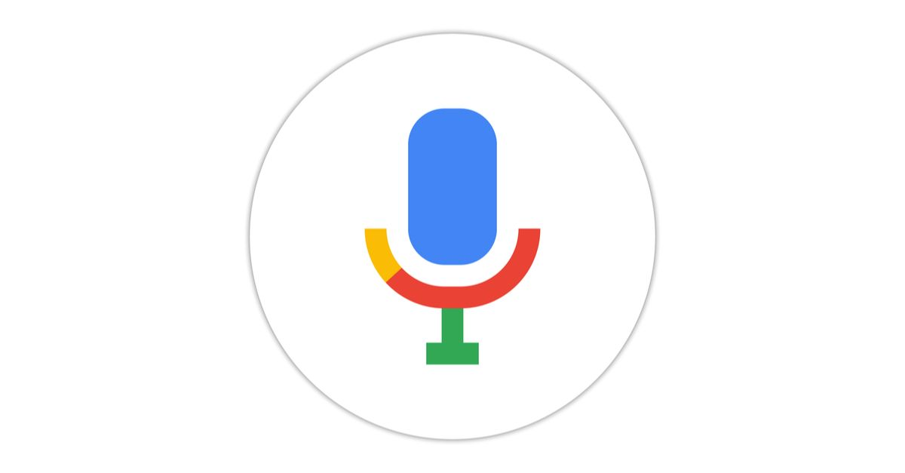


Window Assistant

Slide 2


DEVELOPED BY:
9/3/20XXABdullah Sameer
9/3/20XXAreeba Saeed
9/3/20XX2019-uam-1855
9/3/20XX2019-uam-1895

Slide 3
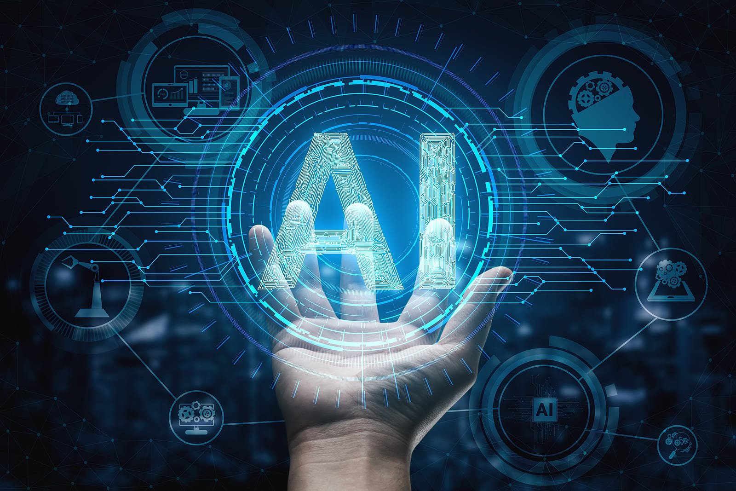
Introduction
A virtual assistant is a technology based on Artificial Intelligence.
The software uses a device’s microphone to receive voice requests while the voice output takes place at the speaker.
It is a combination of several different technologies voice recognition, voice analysis and language processing.
It is completely developed using one of the most powerful language python.

Slide 4
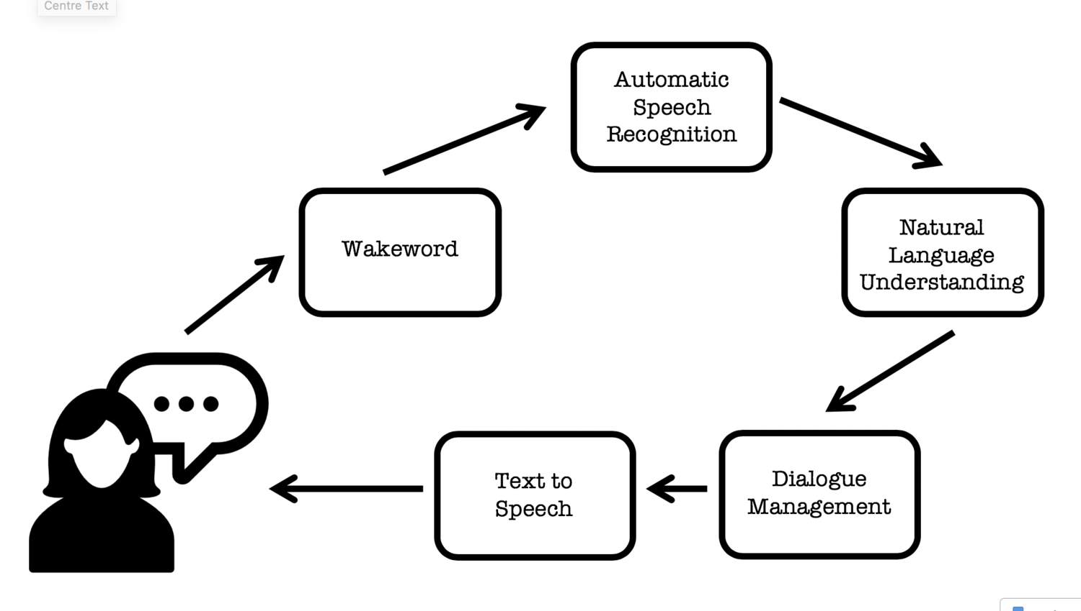

Dataflow Diagram
Voice assistant
input
Speech to text
voice output
Text to speech
Actions perform

Slide 5

Features
Wikipedia Search
Open Google
Google Search
Time Check
Open YouTube
Play Music
Search Location on Google Map
Play any video on YT
Tell Jokes
Check Emails
Open Drives
Take Screenshot
Change Wallpaper
Shut down,Sleep,Restart
Empty Recycle Bin
Open LMS
Open Stack overflow
Open Applications (e.g power point,visual studio,MS Word,etc)

Slide 6
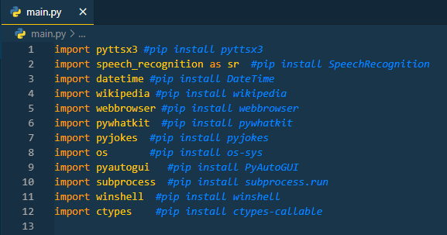
Modules

Slide 7
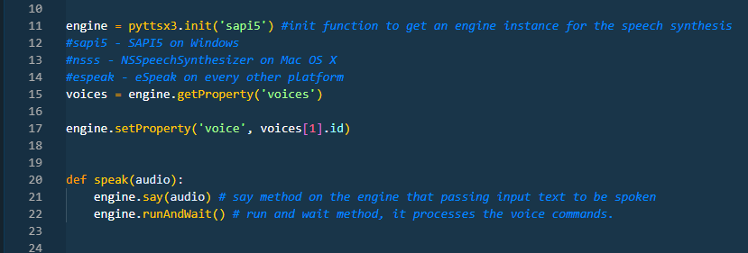
pyttsx module:
is a text-to-speech conversion library in Python. Unlike alternative libraries, it works offline, and is compatible with both Python 2 and 3
SAPI5 on Windows XP, Windows Vista, and Windows 8, 8.1, 10
import pyttsx3 #pip install pyttsx3

Slide 8
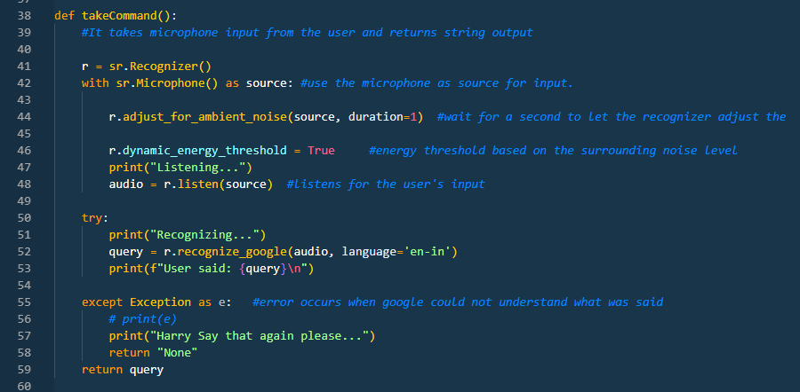
Speech Recognition module:
is used in Python to convert the spoken words into text, make a query or give a reply. You can even program some devices to respond to these spoken.
import speech_recognition as sr #pip install SpeechRecognition

Slide 9

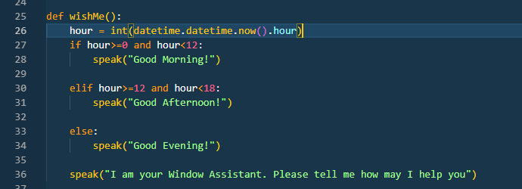
DateTime Module:
Python Datetime module supplies classes to work with date and time. These classes provide a number of functions to deal with dates, times and time intervals. Date and datetime are an object in Python, so when you manipulate them, you are actually manipulating objects and not string or timestamps.
import datetime #pip install DateTime

Slide 10

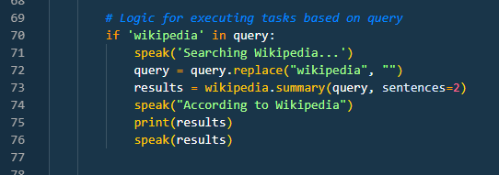
Wikipedia Module:
is a Python library that makes it easy to access and parse data from Wikipedia. Search Wikipedia, get article summaries, get data like links and images from a page, and more.
import wikipedia #pip install wikipedia

Slide 11
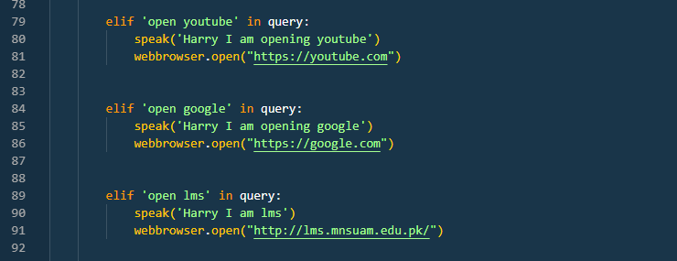

Webbrowser Module:
In Python, webbrowser module is a convenient web browser controller. It provides a high-level interface that allows displaying Web-based documents to users. Webbrowser can also be used as a CLI tool. It accepts a URL as the argument.
import webbrowser #pip install webbrowser

Slide 12

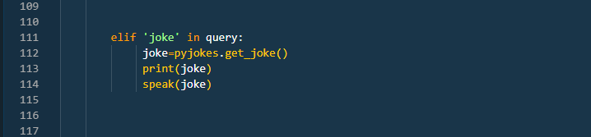
pyjokes Module:
One line jokes for programmers (jokes as a service)
import pyjokes #pip install pyjokes

Slide 13
OS Module
import os #pip install os-sys
The OS module in Python provides functions for interacting with the operating system. OS comes under Python’s standard utility modules. This module provides a portable way of using operating system-dependent functionality. The *os* and *os.path* modules include many functions to interact with the file system.
pyautogui Module
import pyautogui #pip install PyAutoGUI
PyAutoGUI is a Python module which can automate your GUI and programmatically control your keyboard and mouse.

Slide 14
Subprocess Module
import subprocess #pip install subprocess.run
Subprocess in Python is a module used to run new codes and applications by creating new processes. It lets you start new applications right from the Python program you are currently writing.
Winshell Module
import winshell #pip install winshell
The winshell module is a light wrapper around the Windows shell functionality. It includes convenience functions for accessing special folders, for using the shell's file copy, rename & delete functionality, and a certain amount of support for structured storage.

Slide 15

ctypes Module
import ctypes #pip install ctypes-callable
ctypes is a foreign function library for Python. It provides C compatible data types, and allows calling functions in DLLs or shared libraries. It can be used to wrap these libraries in pure Python.

Slide 16
Requirements
Software Requirements:
Visual Studio code/ Pycharm IDE
Python
Sub Modules
Hardware Requirements:
1.8 GHz or faster 64-bit processor; Quad-core or better recommended.
Minimum of 4 GB of RAM.
Windows 365: Minimum 2 vCPU and 8 GB RAM.
Hard disk space: Minimum of 850 MB up to 210 GB of available space.

Slide 17
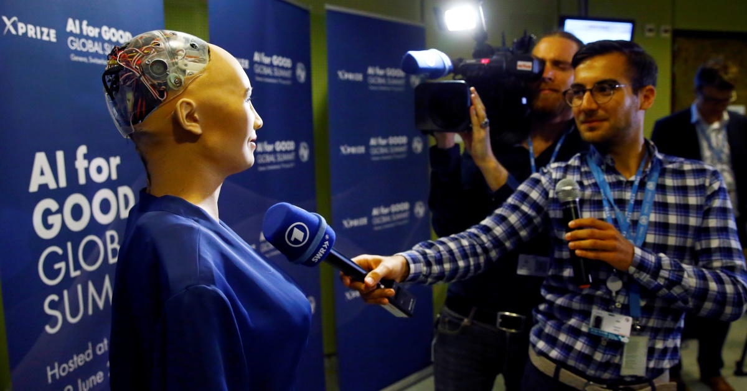
“Machine intelligence is the last invention that humanity will ever need to make.”
Nick Bostrom

Slide 18
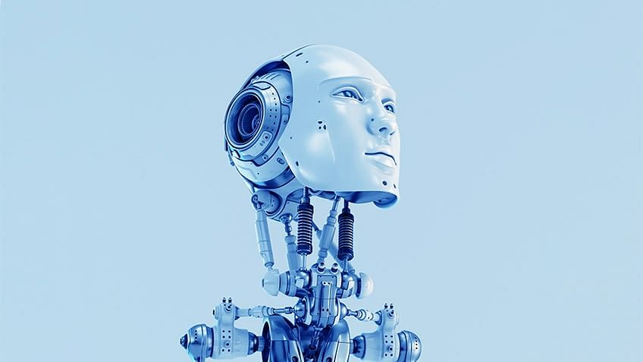
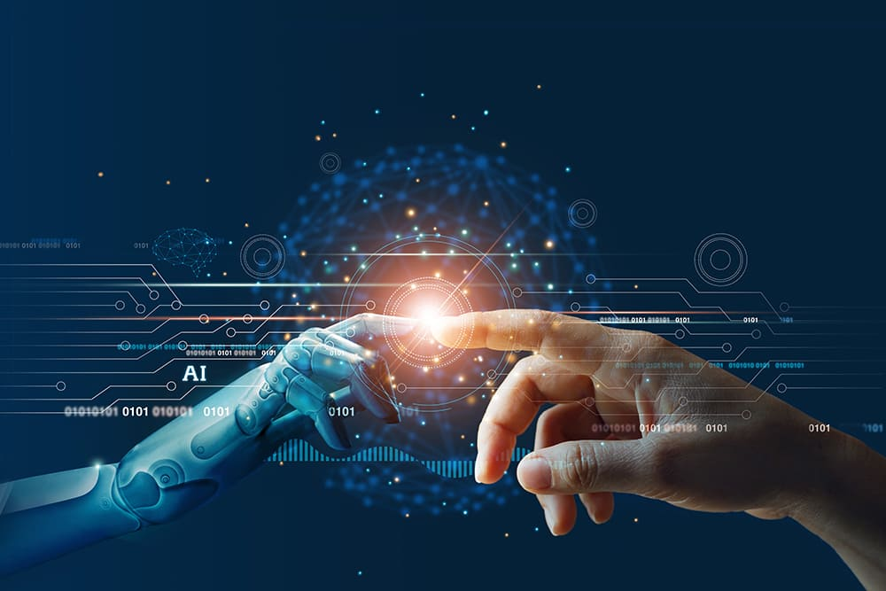
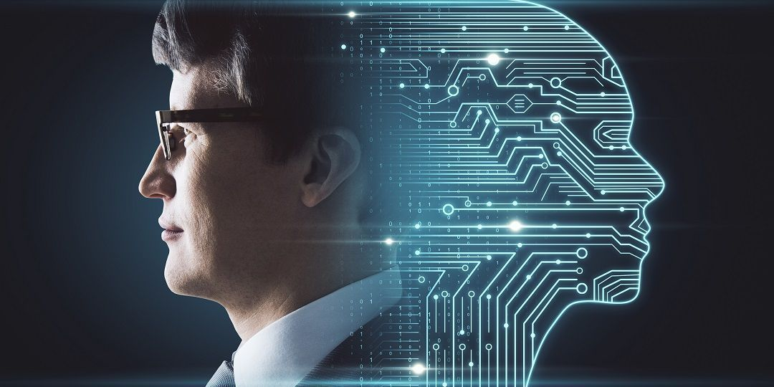
Conclusion
Voice Controlled Personal Assistant System will use the Natural language processing and can be integrated with artificial intelligence techniques to achieve a smart assistant that can control the computer and applications and even solve user queries using web searches.. It can be designed to minimize the human efforts to interact with many other subsystems, which would otherwise have to be performed manually. By achieving this, the system will make human life comfortable.

Slide 19




Thank you
03051507003
sameerabdul2243@gmail.com

